Slide 1
Windows Azure Cloud Service
方兴 xinfang@microsoft.com
DPE

Slide 2
一个程序的上线运行需要什么？
开发测试
部署
运维
开发工具
测试环境
代码打包
单机准备：OS/.NET/J2EE
集群与负载均衡配置
日志查询
故障信息查询
性能监控
系统扩容、减容
代码升级、版本切换
Azure SDK
Azure Cloud Service

Slide 3

Azure Cloud Service 是一个整合管理的运行环境
Cloud Service是什么？
支持多层架构的应用容器
由多个Windows虚拟机集群构成
集群有两种类型：Web和Worker
Cloud Service 做什么
进行应用的自动化部署
维护所有虚机的操作系统/补丁/IIS
进行每个集群的故障排除和负载均衡
进行集中监控、日志收集
普通应用如何发布为Cloud Service
应用中去除状态
用VS/Eclipse进行打包
部署
运维
通过Azure单点发布应用程序代码
运维人员通过管理门户统一维护各种配置，如数据库连接等
Cloud Service
Web Role
Worker Role
VM₁
VM₂
VM₃
VM₄
VM₁
VM₂
VM₃
VM₄
VM₅
VM₆
VM_{n}
VM₅
VM_{n}
…
…
Web Role的每台虚机运行有IIS，用于处理Web请求
Worker Role用于运行后台进程
特点：无状态、打包发布、弹性伸缩

Slide 4
支持丰富的应用类型
基本原则
  所有Windows应用都可以
语言
  C#, VB, C++, Java, PHP, Node.js, Phython, etc.
运行环境框架
  .NET, ExpressJS, Rails, Zend, etc.

Slide 5
一个例子
在传统方式下，开发和部署人员需关注物理实体的配置细节，并维护之间的关联
物理实体的配置信息包括：
IP地址、端口
各服务器配置
物理磁盘路径
IP4
批处理服务器
IP1
IIS服务器
IP3
VIP
负载均衡器
负载均衡器
主数据库
IIS服务器
IP2
备数据库

Slide 6
该例子移植到Azure后
DNS1
在Cloud Service下，只需关注逻辑实体(Role)的配置和关联
具有相同功能的一组节点被当作一个集群统一管理，
抽象为Role
一个应用可以由多个Role组成，应用的配置包括
域名、外部端口
全局变量
每个Role的配置信息包括：
部署代码
端口
虚机规格、OS版本
初始虚机数量
环境变量（如数据库、存储连接地址）
Web Role
Worker Role
IIS虚拟机1
虚拟机1
IIS虚拟机N
虚拟机N
DNS2
SQL Azure 服务
实例1
实例2
实例3

Slide 7
为了提高集群的可用性，虚拟机会被部署到不同的故障域和升级域中
Fault Domain
  降低因非计划停机带来的应用停机风险
  Azure将整个数据中心划分为多个Fault Domain，他们同时故障的概率较低
  会自动将每个Role的多个虚机分散到不同的Fault Domain上
Upgrade Domain
  降低因计划停机带来的应用停机风险
  Azure每个月会对物理机和虚机进行数次维护
  Azure将整个数据中心划分为多个Upgade Domain，每次维护一个Upgrade Domain
  Azure会自动将每个Role的多个虚机分散到不同的Upgrade Domain上
  单一虚机不可靠，不建议存储状态信息及数据
  每个Role建议至少2个虚机实例
  Role 99.95%可用性
Notes:
The infrastructure of each Windows Azure data center is notionally divided into multiple sections known as fault domains. These sections of the infrastructure (which are not necessarily individual servers or server racks) are designed in such a way that a failure of one fault domain is extremely unlikely to affect any other fault domain. When you deploy a service, the Windows Azure Fabric Controller automatically locates the roles in at least two different fault domains so that a failure in one domain will not affect all instances of your service.

Slide 8
Fault Domain示意
Example role with nine virtual machines distributed across three fault domains
Network Load Balancer
Role
Fault Domain 1
Fault Domain 2
Fault Domain 3
VM₁
VM₃
VM₂
VM₄
VM₆
VM₉
VM₅
VM₈
VM₆
VM₉
Notes:
Slide Objective
Understand what a scale-out application looks like
Speaking notes
High scale applications often follow this sort of an pattern
Inbound connectivity comes through a load balancer
Requests are round robin routed
Load balancer is typically aware of the state of the web servers (i.e. are they up)
There are one or more tiers or groups of stateless web or app servers
By stateless we mean that they do not hold state between client requests
Stateless means that simple load balancing works – no need for sticky sessions
Stateless means that the failure of a web server does not cause major issues for application- it is simply removed from the load balancer
A stateful or storage tier
This will generally involve some sort of scale out approach for large apps
Often using partitioned databases
Often some sort of queuing mechanism
Applications will often perform processing in the background.
Improves response time for users
Allows load peaks to be buffered in queues
Windows Azure provides us with a Platform as a Service offering to implement these sorts of applications
Notes
http://msdn.microsoft.com/en-us/magazine/cc500561.aspx
http://msdn.microsoft.com/en-us/library/ff650667.aspx

Slide 9
构建高可扩展、高可用的Azure应用
将状态信息、数据存储在Azure的各种数据服务上
负载均衡器
Azure
管理门户
无状态的Web节点
无状态的Web节点
应用发布、配置、监控
无状态的Web节点
可独立
横向扩展
无状态的Worker节点
无状态的Worker节点
Shared Cache
Queues
Table
Blob
Drive
SQL Azure或其他数据库
Notes:
Slide Objective
Understand what a scale-out application looks like
Speaking notes
High scale applications often follow this sort of an pattern
Inbound connectivity comes through a load balancer
Requests are round robin routed
Load balancer is typically aware of the state of the web servers (i.e. are they up)
There are one or more tiers or groups of stateless web or app servers
By stateless we mean that they do not hold state between client requests
Stateless means that simple load balancing works – no need for sticky sessions
Stateless means that the failure of a web server does not cause major issues for application- it is simply removed from the load balancer
A stateful or storage tier
This will generally involve some sort of scale out approach for large apps
Often using partitioned databases
Often some sort of queuing mechanism
Applications will often perform processing in the background.
Improves response time for users
Allows load peaks to be buffered in queues
Windows Azure provides us with a Platform as a Service offering to implement these sorts of applications
Notes
http://msdn.microsoft.com/en-us/magazine/cc500561.aspx
http://msdn.microsoft.com/en-us/library/ff650667.aspx

Slide 10
客户请求
负载均衡器
Azure
管理门户
无状态的Web节点
无状态的Web节点
应用发布、配置、监控
无状态的Web节点
可独立
横向扩展
无状态的Worker节点
无状态的Worker节点
Shared Cache
Queues
Table
Blob
Drive
SQL Azure或其他数据库
Notes:
Slide Objective
Understand what a scale-out application looks like
Speaking notes
High scale applications often follow this sort of an pattern
Inbound connectivity comes through a load balancer
Requests are round robin routed
Load balancer is typically aware of the state of the web servers (i.e. are they up)
There are one or more tiers or groups of stateless web or app servers
By stateless we mean that they do not hold state between client requests
Stateless means that simple load balancing works – no need for sticky sessions
Stateless means that the failure of a web server does not cause major issues for application- it is simply removed from the load balancer
A stateful or storage tier
This will generally involve some sort of scale out approach for large apps
Often using partitioned databases
Often some sort of queuing mechanism
Applications will often perform processing in the background.
Improves response time for users
Allows load peaks to be buffered in queues
Windows Azure provides us with a Platform as a Service offering to implement these sorts of applications
Notes
http://msdn.microsoft.com/en-us/magazine/cc500561.aspx
http://msdn.microsoft.com/en-us/library/ff650667.aspx

Slide 11


一个典型的应用
Azure Cloud service
Web Role
Worker Role
❻性能监控/故障排除/配置优化/容量管理
❸访问
负载均衡
❹在Table中生成记录，
将源图片存在Blob中，
互联网用户
生成一个消息通知Worker
IIS集群
❺读取消息，将Blob更新为小图片，更新Table
Windows集群
Queue
❷上传至Azure
Table
❶ 打包代码
Blob
工具：Visual studio
运维人员
Azure Storage服务
Notes:
在界面创建一个云服务
在VS中查看Guestbook，打包
部署代码，访问
管理

Slide 12
Cloud services
Demo
Notes:
提前部署好GuestBook项目，演示时直接展示门户

Slide 13




如何选择服务
简化的管理,Devops
更大的自主性
网站服务
云服务
虚拟机服务
Windows Server
适合场景：Web应用，单层架构，频繁更新
局限
无admin权限
无法自己开socket
Windows Server
适合场景：Server端应用，多层架构
局限：
节点无状态，磁盘不持久
需要一定的代码修改
Windows/Linux
适合场景：各种场景
局限
自己维护OS
难以弹性伸缩
Notes:
Windows OS
优点
无需代码修改
无需管理运行环境
快速部署及更新代码
集成开发工具及源代码管理
秒级扩容、收缩
集成监控

Slide 14
Windows Azure SDKs and Tools
.Net
  Visual Studio Tools
  Client Libraries for .Net
Node.js
  PowerShell Tools
  Node.js for Windows
  IISNode
  Client Libraries for Node.js
Java
  Eclipse Tools
  Client Libraries for Java
Php/Python
  Command Line Tools
  Client Libraries

Slide 15

Windows Azure for .Net Developers
Windows Azure SDK for .Net
Windows Server 2008, Windows 7 or Windows 8
SQL Express 2005+
.NET 3.5 SP1+
Development Fabric
Development Storage
.NET APIs
Visual Studio 2010/2012
Project Templates
Model & Config Tooling
Package & 1 Click Deploy
Debugging Support
Storage Explorer
Server Explorer
IntelliTrace Support
Profiling Support
Notes:
Slide Objective
Introduce users to the tooling available to work with Windows Azure
Speaker Notes
Developer SDK is a Cloud in a box, allowing you to develop and debug locally without requiring a connection to the cloud. You can do this without Visual Studio as there are command line tools for executing the “cloud in a box” and publishing to the cloud.
There is also a separate download for the Visual Studio 2008 tools, which provide the VS debugging and templates. This in turn includes the SDK
Download the VS tools if you use VS. Download the raw SDK if you use alternative platforms (PHP etc…)
Requirements for Win 7 or Win 2008 are a dependency on IIS7 for the development fabric
Can install the bits with the Microsoft Web Platform Installer
Notes
Windows Azure Tools for Microsoft Visual Studio includes:
C# and VB Project creation support for creating a Windows Azure Cloud Service solution with multiple roles.
Tools to add and remove roles from the Cloud Service.
Tools to configure each Role.
Integrated local development via the Development Fabric and Development Storage services.
Running and Debugging a Cloud Service in the Development Fabric.
Browsing cloud storage through the Server Explorer
Building and packaging of Cloud Service Packages.
Deploying to the Windows Azure.
Monitoring the state of your services through the Server Explorer.
Debugging in the cloud by retrieving IntelliTrace logs through the Server Explorer.

Slide 16
Role Lifecycle
All roles may extend RoleEntryPoint
Roles report status via RoleEnvironment
Methods
Events
Status
Fabric Calls
OnStart
StatusCheck
Busy
Requests Routed
Run
StatusCheck
Ready
Role Lifetime
OnStop
StatusCheck
Busy
Stopping
Notes:
Slide Objective
Understand the lifecycle of a Windows Azure role
Understand the methods that can be overridden in RoleEntryPoint
Understand the events that are raised by role instances when their status is changing
Speaker Notes
Roles will typically extend RoleEntryPoint
The fabric calls RoleEntryPoint methods as it starts and stops a role
WaWorkerHost process is started.
Worker Role assembly is loaded and surfed for a class that derives from RoleEntryPoint. This class is instantiated.
RoleEntryPoint.OnStart() is called.
RoleEntryPoint.Run() is called.
If the RoleEntryPoint.Run() method exits, the RoleEntryPoint.OnStop() method is called .
WaWorkerHost process is stopped. The role will recycle and startup again.
As a role changes state it will raise the StatusCheck event.
A status of Busy will mean the load balancer will not route requests to the instance.
Note
http://blogs.msdn.com/b/jnak/archive/2010/02/11/windows-azure-roleentrypoint-method-call-order.aspx
http://msdn.microsoft.com/en-us/library/ee848065.aspx

Slide 17
针对.NET Role，可以编写一个类自定义Role在不同阶段的行为
Inherits RoleEntryPoint
OnStart() Method
  Called by Fabric on startup, allows you to perform initialization tasks.
  Reports Busy status to load balancer until you return true.
Run()
Method
  Main logic is here – can do anything, typically infinite loop. Should never exit.
OnStop() Method
  Called when role is to be shutdown, graceful exit.
  30 Seconds to tidy up.
Notes:
Slide Objective
Understand the role programming model in overview
Speaker Notes
A role is similar to a windows service. It gets started once deployed, and will get stopped when required.
It could get stopped because
we are re-deploying you to a different server
You actioned the stop from the web-portal
It’s up to you to keep running and NEVER return from Start() unless you have been told to stop. Note: you do not need to handle the stop – you can simply “fail”
Notes
http://msdn.microsoft.com/en-us/library/ee848065.aspx
http://blogs.msdn.com/b/jnak/archive/2010/02/11/windows-azure-roleentrypoint-method-call-order.aspxes

Slide 18
针对非.NET Role，可以在配置文件中自定义 Role在不同阶段的行为
执行一条命令，如文件拷贝
运行一个程序，如Java
<?xml version="1.0" encoding="utf-8"?>
<ServiceDefinition name="WindowsAzureProject11" xmlns="http://schemas.microsoft.com/ServiceHosting/2008/10/ServiceDefinition">
<WorkerRole name="WorkerRole1" vmsize="Small">
<Runtime executionContext="limited">
<EntryPoint>
<ProgramEntryPoint commandLine="myProcess.exe" setReadyOnProcessStart="true" />
</EntryPoint>
</Runtime>
<Endpoints>
<InputEndpoint name="Endpoint1" protocol="tcp" port="80" />
</Endpoints>
</WorkerRole>
</ServiceDefinition>

Slide 19
Worker Role Patterns
Queue Polling Worker
  Poll and Pop Messages within while(true) loop
  E.g. Map/Reduce pattern, background image processing
Listening Worker Role
  Create TcpListener or WCF Service Host
  E.g. Run a .NET SMTP server or WCF Service
External Process Worker Role
  OnStart or Run method executes Process.Start()
  Startup Task installs or executes background/foreground process
  Custom Role Entry Point (executable or .Net assembly)
  E.g. Run a database server, web server, distributed cache
Notes:
Slide Objective
Understand the 3 common patterns of worker roles
Speaker Notes
Pattern 1 – Polling
Worker role polls a Queue
Pops message
Performs work
Polls queue again
Pattern 2
Worker listens for inbound TCP request
Can implement with Raw TcpListeners or use WCF or use Hosted Web Core
Pattern 3
Run a 3rd party process
When the role starts up or runs use a Process.Start() call to run a standard windows executable
E.g. Running a database server
Notes
http://blog.smarx.com/posts/build-your-own-web-role-running-hosted-web-core-in-windows-azure
http://blog.smarx.com/posts/making-songs-swing-with-windows-azure-python-and-the-echo-nest-api

Slide 20
Web Role
All features of a worker role + IIS 7 or 7.5
ASP.NET 3.5 SP1 or 4.0 – 64bit
Hosts
  Webforms or MVC
  FastCGI applications (e.g. PHP)
  Multiple Websites
Http(s)
Web/Worker Hybrid
  Can optionally implement RoleEntryPoint
Notes:
Slide Objective
Understand how a Web Role extends the standard worker role
Speaker Notes
A web role takes all the capabilities and semantics of a worker role and adds the IIS Hostable Web Core
Web Roles run ASP.NET websites- they do this by using the IIS hostage web core.
pretty much anything that will work in a standard IIS ASP.NET Web Site should work in Windows Azure. At MIX09, we additionally added support for IIS7’s FastCGI capability. As a note, any files that are part of a asp.net project on windows azure are READ ONLY! If you need to be able to change the contents of files:
User Blob Storage
If its configuration, use the service model files – which can be changed at runtime.
Inbound protocols are http(s) – outbound protocols are any TCP connection but NOT UDP.
Notes
http://msdn.microsoft.com/en-us/library/dd179341.aspx
http://blogs.msdn.com/b/carlosag/archive/2008/04/14/hostyourownwebserverusingiis7.aspx
http://blogs.iis.net/ksingla/archive/2007/12/20/ins-amp-outs-of-hostable-web-core.aspx

Slide 21
Cloud Service的3个部署文件
Windows Azure Services are described by two important artifacts:
  Service Definition (*.csdef)
  Service Configuration (*.cscfg)
Your code is zipped and packaged with definition (*.cspkg)
  Encrypted(Zipped(Code + *.csdef)) == *.cspkg
Windows Azure consumes just (*.cspkg + *.cscfg)

Slide 22
Service Definition
Describes the shape of your
Windows Azure Service
  Defines Roles, Ports, Certificates, Configuration Settings,
  Startup Tasks, IIS Configuration, and more…
Can only be changed by upgrades
or new deployments

Slide 23
Service Definition
<?xml version="1.0" encoding="utf-8"?>
<ServiceDefinition name="WebDeploy" xmlns="http://schemas.microsoft.com/ServiceHosting/2008/10/ServiceDefinition">
  <WebRole name="WebUX">
    <Startup>
      <Task commandLine="..\Startup\EnableWebAdmin.cmd" executionContext="elevated" taskType="simple" />
    </Startup>
    <Imports>
      <Import moduleName="RemoteAccess" />
      <Import moduleName="RemoteForwarder"/>
    </Imports>
    <Sites>
      <Site name="Web">
        <Bindings>
        <Binding name="HttpIn" endpointName="HttpIn"/>
        </Bindings>
      </Site>
    </Sites>
    <Endpoints>
      <InputEndpoint name="HttpIn" protocol="http" port="80"/>
      <InputEndpoint name="mgmtsvc" protocol="tcp" port="8172" localPort="8712"/>
    </Endpoints>

Slide 24
Service Configuration
Supplies Runtime Values
(Scale, Config Settings, Certificates to use, VHD, etc.)
Can be updated any time through Portal or API

Slide 25
Service Configuration
<?xml version="1.0"?>
<ServiceConfiguration serviceName="WebDeploy" xmlns="http://schemas.microsoft.com/serviceHosting/2008/10ServiceConfiguration">
<Role name="Webux">
<Instances count="1"/>
<ConfigurationSettings>
<Setting name="DiagnosticsConnectionString" value="UseDevelopmentStorage=true/>
<Setting name="Microsoft.WindowsAzure.plugins.RemoteAccess.Enabled" value="True"/>
<Setting name="Microsoft.WindowsAzure.plugins.RemoteAccess.AccountUsername" value="dunnry"/>
<Setting name="Microsoft.WindowsAzure.plugins.RemoteAccess.AccountEncryptedPassword" value="MIIBrAYJKoZIhvcNAQcDoIIB"/>
<Setting name="Microsoft.WindowsAzure.plugins.RemoteAccess.AccountExpiration" value="2010-12-23T23:59:59.0000000-07"/>
<Setting name="Microsoft.Windows Azure.Plugins.RemoteForwarder.Enabled" value="True"/>
<ConfigurationSettings>
<Certificate>
<Certificates name="Microsoft.WindowsAzure.Plugins.remoteAccess.PasswordEncryption" thumbprint="D6BE55AC439FAC6CBEBAF"/>
</Certificate>
</Role>
</ServiceConfiguration>

Slide 26
VM Size in Windows Azure
Windows Azure
  Supports Various VM Sizes
  Size set on Role in Service Definition - All instances of role will be of equal size
  Service can have multiple roles
  Balance of Performance per node vs. High Availability from multiple nodes
VM Size | CPU Cores | CPU Speed | Memory | Bandwidth | # Data Disks | Local Storage | Cost (USD)
Extra Small | Shared | 1.0 GHz | 768 MB | 5 (Mbps) | 1 | 20GB | 0.02
Small | 1 | 1.6 GHz | 1.75 GB | 100 (Mbps) | 2 | 225GB | 0.12
Medium | 2 | 1.6 GHz | 3.5 GB | 200 (Mbps) | 4 | 490GB | 0.24
Large | 4 | 1.6 GHz | 7 GB | 400 (Mbps) | 8 | 1,000GB | 0.48
Extra Large | 8 | 1.6 GHz | 14 GB | 800 (Mbps) | 16 | 2,040GB | 0.96
Notes:
Slide Objective
To understand how and why to change the VM Size for a Windows Azure role
Slide Notes
When you create your service model, you can specify the size of the virtual machine (VM) to which to deploy instances of your role, depending on its resource requirements.
The size of the VM determines
the number of CPU cores
the memory capacity
the local file system size allocated to a running instance
Each physical machine in Windows Azure contains 8 processor cores. You need to specify an XL instance to reserve an entire machine
Network is shared but burstable
Can burst beyond your 1/8th allocation when using a small VM
May be limited to just your allocation
For guaranteed high network throughput use an XL VM
Not
http://msdn.microsoft.com/en-us/library/ee814754.aspxes

Slide 27
Choosing Your VM Size
Don’t just throw big VMs at every problem
Scale out architectures have natural parallelism
Some scenarios will benefit from more cores
Where moving data >$ parallel overhead
E.g. Video processing, Stateful services (DBMS)
Test various configurations under load
More small instances == more redundancy

Slide 28
Cloud service网络配置
一个Cloud Service对外只有一个DNS对应一个IP，称为VIP; 跨Cloud service的访问只能通过VIP/DNS
所有的虚机IP对外不可见，称为DIP
Role内部各虚机通过DIP可互访
缺省情况下，不同Role的虚机不可互访
定义端口访问策略后，Role才可以从外部访问
  Input endpoint: 从互联网可访问，多个虚机负载均衡
  Internal endpoint：从Service内其他Role可访问，可细化定义允许哪些Role访问
  Instance endpoint：从互联网可访问，虚机与外部端口一一对应
DNS: xxx.cloudapp.net, VIP: xx.xx.xx.xx
80
边界防火墙及负载均衡
1000
1001
1002
Cloud service
Role 1
Role 2
Role 3
80
80
80
80
80
80
1000
1000
1000
VM₁
VM₂
VM₃
VM₁
VM₂
VM₃
VM₁
VM₂
VM₃
Input Endpoint：80，对外8080
Internal Endpoint：80，允许Role1访问
Instance Input Endpoint：1000，对外1000-1002
Notes:
Input Endpoint
Load-balanced endpoint. Stable VIP per service.
Single port per endpoint.
Supported protocols: HTTP, HTTPS, TCP, UDP
Internal Endpoint
Instance-to-instance communication
Supported protocols: HTTP, TCP, UDP
Port range supported
Instance Input Endpoint
Address specific service role instance
Supported protocols: TCP, UDP

Slide 29
本地磁盘仅用于存储临时数据
Role instances have available disk storage
Use LocalStorage element
in service definition
  Name
  CleanOnRoleRecycle
  Size
  Persistent but not guaranteed durable
  Good for cached resources or temporary files
Windows Azure Storage Drives provide
guaranteed durable storage
Notes:
Slide Objective
To introduce the concept of local storage
Speaker Notes
A local storage resource is a reserved directory in the file system of the virtual machine (VM) in which an instance of a role is running.
Code running in the instance can write to the local storage resource when it needs to write to or read from to a file.
For example, a local storage resource can be used as a temporary folder when manipulating data or generating documents.
Local storage is never guaranteed as persistent; CleanOnRoleRecyle = false is useful to minimise need to rebuild cache for example
For guaranteed long term drive based storage- e.g. to hold database files. Use Windows Azure Storage Drives
Notes
http://msdn.microsoft.com/en-us/library/ee758708.aspx

Slide 30
不建议直接用绝对路径访问本地磁盘，应采用RoleEnvironment获得访问路径
<LocalResources>
<LocalStoragename="myLocalDisk" sizeInMB="10"
cleanOnRoleRecycle="false" />
</LocalResources>
Define in Config
Use in Code
string rootPath = RoleEnvironment.GetLocalResource["myLocalDisk"].RootPath;
DirectoryInfo di = new DirectoryInfo(rootPath);
foreach(di.EnumerateFiles())
….
Notes:
Slide Objective
To show how to implement local storage
Speaker Notes
To declare a local storage resource within the service definition file
add the LocalResources element as a child of a WebRole or WorkerRole element
then add a LocalStorage element to represent the resource.
The LocalStorage element takes three attributes: name, sizeInMB, and cleanOnRoleRecycle.
The sizeInMB attribute specifies the desired size for this local storage resource.
The cleanOnRoleRecycle attribute specifies whether the local storage resource should be wiped clean when a role instance is recycled, or whether it should be persisted across the role lifecycle; the default value is true.
The Windows Azure Managed Library provides classes for accessing the local storage resource from within code running in a role instance. The RoleEnvironment.GetLocalResource method returns a reference to a named LocalResource object.
Because the LocalResource object represents a directory, you can read from it and write to it using the standard .NET file I/O classes. To determine the path to the local storage resource's directory, use the LocalResource.RootPath property
Notes
http://msdn.microsoft.com/en-us/library/ee758708.aspx

Slide 31
VIP Swap
Network Load Balancer
Role
Production
Staging
Production
Staging
Package
VM₁
VM₂
VM₁
VM₂
VM₃
VM₄
VM₃
VM₄

Slide 32
日志诊断信息Diagnostics
运行顺序如下
Role Instance Starts
Diagnostic Monitor Starts
Monitor is configured
  Imperatively at Start time
  Remotely any time
  Configuration is saved in Storage
Monitor buffers data locally
  User can set a quota (FIFO)
Transfer to storage from local buffer
  Scheduled
  On Demand
Role Instance
Role
Diagnostic
Monitors
Local directory storage
Azure Storage
通过编程或者修改diagnostics.wadcfg配置文件可改变Diagnostics行为

Slide 33
Diagnostic Data Locations
WAD-Control-Container
Contains XML Configuration for each Role Instance in the Service
Diagnostic Data | Location in Storage
Windows Event Logs | WADWindowsEventLogsTable
Performance Counters (including custom performance counters) | WADPerformanceCountersTable
Windows Azure Logs | WADLogsTable
Diagnostic Infrastructure Logs | WADDiagnosticInfrastructureLogsTable
IIS Logs | wad-iis-logfiles - WADDirectoriesTable (index entry)
IIS Failed Request Logs | wad-iis-failedreqlogfiles - WADDirectoriesTable (index entry)
Crash Dumps | wad-crash-dumps - WADDirectoriesTable (index entry)
Custom File Based Logs | (must be configured) - WADDirectoriesTable (index entry)

Slide 34
Cloud services:
将一个现有.NET应用发布为Cloud Service
Demo
Notes:
创建一个ASP.NET应用
将其添加到Cloud service里
查看生成的Web/workerRole.cs，及Onstart/onstop/run方法
查看csdef/cscfg

Slide 35
一些常见问题
Website服务和cloud service的区别？
  Website可以看成是一种特殊的Cloud service，专门用于提供IIS服务
  Website不支持Java，不支持Python
  Website的虚机对用户不可见，无法安装其他软件，无法灵活配置
  Website没有Worker Role，不适合执行长任务和后台任务
传统.NET应用和Cloud service应用有什么区别？
  Cloud service增加了.csdef/.cscfg文件用于定义云服务属性
  Cloud service增加了一个类实现onstart/onstop/run方法
  Cloud service可以通过RoleEnvironment实例获得对Role环境的访问和控制
开发Cloud service需要注意什么？
  不要在代码中硬编码IP地址、数据库连接，所有对外部对象的引用都放在cscfg里
  不要在本机保留任何状态和数据
  虚机数量动态可变，需确保应用能动态均衡负载
  不要采用主-备方式提供高可用性
如何在Cloud service中运行非.NET应用
  开发一个脚本，实现应用的静默安装、配置和运行
  开发另一个脚本，实现该应用的关闭
  修改.csdef，添加这两个脚本

Slide 36
Summary
Cloud Service is for multi-tier online services
Service model defines service shape
Service configuration defines service scale
Selectable VM Sizes
Upgrading and Deployment

Slide 37
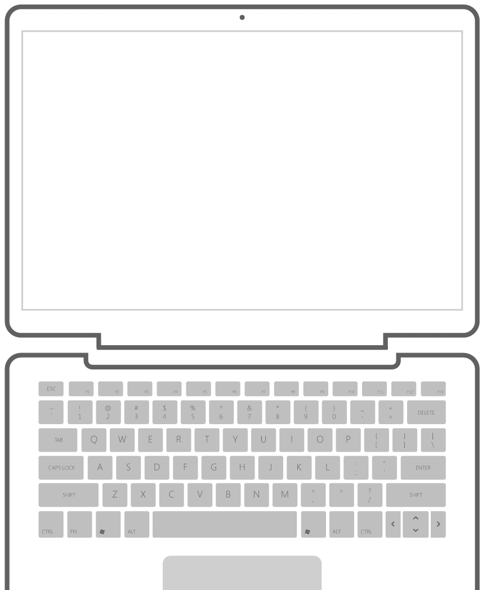
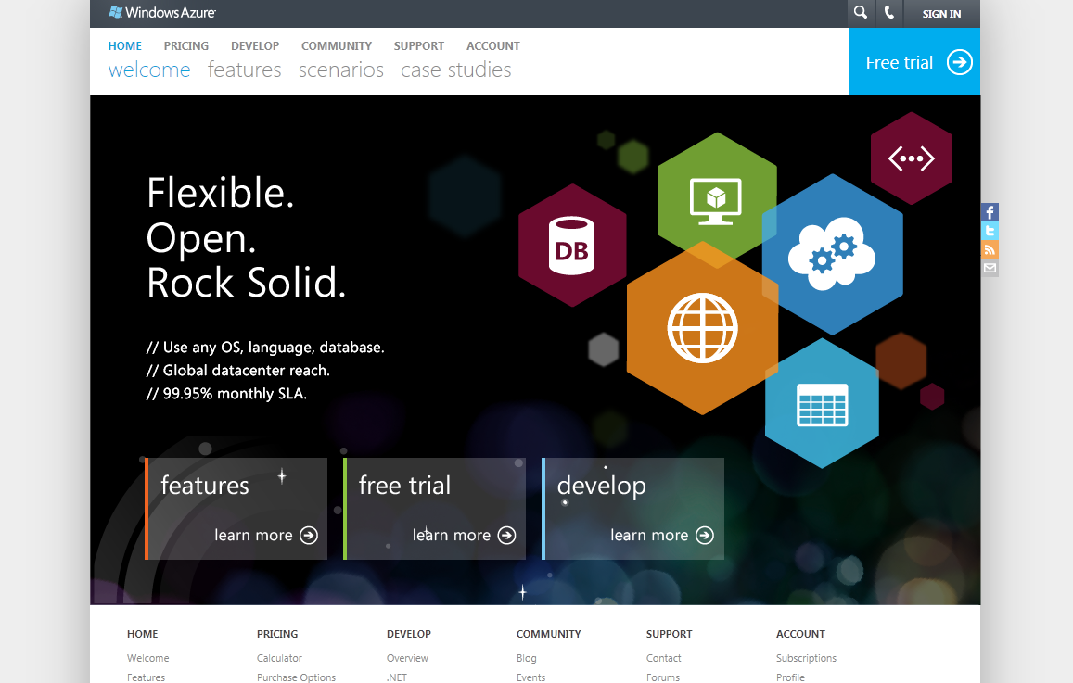
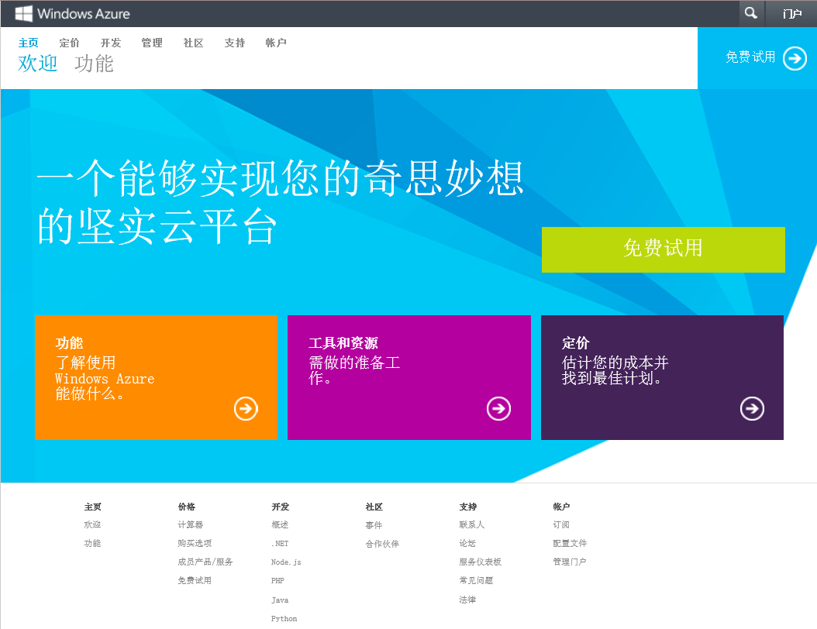
常用资源
中文主页
http://www.windowsazure.com/zh-cn/
培训及实习材料下载http://www.microsoft.com/en-us/download/details.aspx?id=8396
讨论区http://social.msdn.microsoft.com/Forums/zh-CN/windowsazurezhchs/threads
博客：
http://blogs.msdn.com/b/azchina/
http://blog.csdn.net/azurechina
QQ组：289913970
新浪微博：微软云计算

