Slide 1
Azure 虚拟机简介
方兴 微软开发技术顾问
博客：http://blog.csdn.net/shaunfang
Azure技术讨论组(QQ): 289913970
Version: November, 2012

Slide 2


Cloud First Provisioning
Getting Started
Select Image
and VM Size
New Disk Persisted in Storage
Windows Server
Management Portal
Boot VM from New Disk
Linux
>_
Extra Small
Small
Medium
Large
X-Large
Large memory
Scripting
(Windows, Linux and Mac)
Cloud
REST API
Notes:
Slide Objective:
Explain workflow for provisioning VMs in the cloud
Notes:
Cloud First Provisioning means exactly what is says. Building a VM in the cloud first.
You have three methods of starting this process: Build a VM from the portal, from the command line OR programmatically calling the REST API.
Once your choice of provisioning is made you will need to select the image and instance size to start from.
The newly created disk will be stored in blob storage and your machine will boot.

Slide 3





Supported Windows Server Applications
SQL Server 2008
SQL Server 2008 R2
SQL Server 2012
SQL Server 2014 CTP1
Windows Server 2008 R2 SP1
Windows Server 2012
Windows Server 2012
R2
SharePoint 2010 & 2013
BizTalk 2010 & 2013
System Center 2012
http://support.microsoft.com/kb/2721672
Notes:
Windows Server
Windows Server 2008 R2 and later versions are supported for the following roles:
Active Directory Domain Services
Active Directory Federation Services
Active Directory Lightweight Directory Services
Application Server
DNS Server
Fax Server
Network Policy and Access Services
Print and Document Services
Web Server (IIS)
Windows Deployment Services
Windows Server Update Services
File Services

Slide 4





Linux on Windows Azure
We support
  SUSE SLES 11 sp2
  Open SUSE 12.3
  CentOS 6.5 by OpenLogic
  Ubuntu 12.04/12.10/13.04
Specific versions are endorsed
  Integration Components
  Testing and validation by partners
  Bring other variants at your own risk**
**Integration Work will be needed
Notes:
Slide Objectives:
Provide an understanding of which Distributions of Linux are offered in the Windows Azure Image Gallery.
Speaking Points:
1) Only Certain distributions of Linux are officially supported: SUSE Enterprise 11 SP2, OpenSUSE 12.1, CentOS 6.2, Ubuntu 12.04
2) Virtual Machine Images of these Distributions are provided by Partners who are experts in each distribution
3) Other Distributions of Linux can be installed as “Bring-Your-Own-Linux” however, some integration work will be needed.
Notes:
Linux Virtual Machines Product Page: http://www.windowsazure.com/en-us/manage/linux

Slide 5
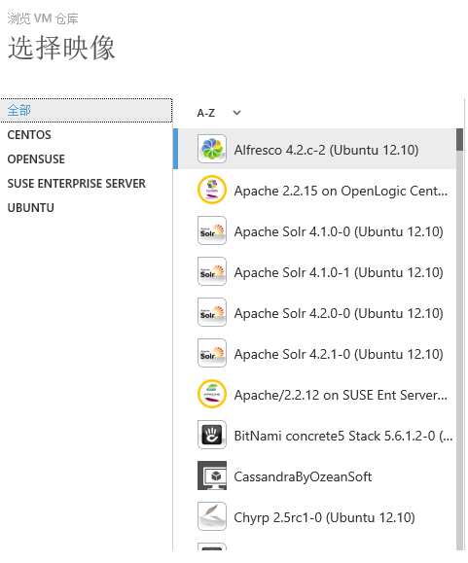
第三方维护的VM仓库
https://vmdepot.msopentech.cn/
可自己打包、上传映像
其他人可以下载、部署

Slide 6
演示
部署虚拟机
Notes:
Get-AzureVM
Get-AzureVMImage | select ImageName
New-AzureQuickVM -Linux -ServiceName myservice8888 -Name myservice8888vm1 -ImageName 0b11de9248dd4d87b18621318e037d37__RightImage-CentOS-6.4-x64-v13.4 -LinuxUser azureuser -Password pass@Azure -Location “East Asia”

Slide 7
磁盘和映像
OS 映像
微软
合作伙伴
用户
对新的虚拟机有基础OS映像
Sys-Prepped/一般化/只读
通过上传或者捕获创建
磁盘
OS 磁盘
数据磁盘
虚拟机的可写磁盘
在虚拟机创建的时候创建或者上传存在的VHD

Slide 8

持久的磁盘和高耐用性
宿主物理机
虚拟机
Windows Azure 存储
Windows Azure 存储
(灾难恢复)

Slide 9
持久的磁盘和高耐用性
宿主物理机
宿主物理机
虚拟机
虚拟机
Windows Azure 存储
Windows Azure 存储
(灾难恢复)

Slide 10
虚拟机磁盘配置
能力 | OS 磁盘 | 数据磁盘 | 临时盘
默认托管的缓存 | 读写 | 无
缺省大小 | Windows 127 GB Linux 30GB |  | 根据虚拟机规格
最大大小 | 127 GB | 1 TB
可以变成映像 | 是 | 否
Windows
C:\ = OS 磁盘
D:\ = 临时盘
E:\, F:\. G:\ ... 数据磁盘
Linux
/dev/sda (挂载点为/) = OS 磁盘
/dev/sdb (挂载点为/mnt/resource) =临时盘
/dev/sdc…数据磁盘
虚拟机创建时，只有OS盘和临时盘

Slide 11
磁盘可以手动迁移
On-Premises
Cloud
MyApp.vhd
Notes:
Slide Objective:
Explain the benefits of image mobility
Notes:
One of the key benefits of IaaS is flexibility and control. The Windows Azure solution provides the capability of not only moving VHDs TO the cloud but also allows you to copy the VHD back down and run it locally or on another cloud provider. Great for testing out production issues or any other need where you require a copy of the production server.

Slide 12
演示
虚拟机磁盘管理
Notes:
Get-AzureVM
Get-AzureVMImage | select ImageName
New-AzureQuickVM -Linux -ServiceName myservice8888 -Name myservice8888vm1 -ImageName 0b11de9248dd4d87b18621318e037d37__RightImage-CentOS-6.4-x64-v13.4 -LinuxUser azureuser -Password pass@Azure -Location “East Asia”

Slide 13
虚拟机网络

Slide 14

首先了解下Azure云服务
云服务是一个容器，对外提供单一的DNS地址和IP地址，内部容纳多个虚拟机
  将内部资源与外部资源隔离
  可以看成是一个应用的边界
  可以当作一个整体管理，进行监控、自动缩放
Cloud Service
VM 1
VM 2
DNS/VIP
VM 3
VM 4
Notes:
There are default limits in Azure as follows:
20 Hosted Service Projects
5 Storage Accounts
5 roles per Hosted Service (i.e. 3 different web roles + 2 different worker roles or any such combination)
20 CPU cores (not instances) across all your Hosted Service Projects
(http://blogs.msdn.com/b/jnak/archive/2010/01/22/windows-azure-instances-storage-limits.aspx)

Slide 15
采用缺省选项创建虚拟机，将自动建立一个云服务
云服务
NAT
外部IP（VIP）
2200端口
内部IP
22端口
VM1
云服务和外部IP一一对应

Slide 16
外部端口定义：ACL与端口映射
云服务
端口定义
外部端口
内部端口
协议 (TCP/UDP)
名称
ACL
端口5586
端口3389
<IP Range>
VM1
内部IP 1
NAT
内部通信无需专门定义
公用IP/VIP
端口5587
端口3389
VM2
内部IP 2

Slide 17
外部端口可增加负载均衡能力
云服务
缺省情况下，Azure根据每个VM的健康状态决定是否向该虚拟机转发请求
VM1
LBHTTP
端口80
LB
VM2
LBHTTP
VM3
LBHTTP

Slide 18
虚拟网络
VM 3
自定义内网地址段
可容纳多个云服务
虚拟网络内均为内网通信
可与外部建立VPN通道
VM 1
LB
VM 2
VM 4
子网1
子网2
VNET

Slide 19
演示
虚拟机端口定义
Notes:
Get-AzureVM
Get-AzureVMImage | select ImageName
New-AzureQuickVM -Linux -ServiceName myservice8888 -Name myservice8888vm1 -ImageName 0b11de9248dd4d87b18621318e037d37__RightImage-CentOS-6.4-x64-v13.4 -LinuxUser azureuser -Password pass@Azure -Location “East Asia”

Slide 20

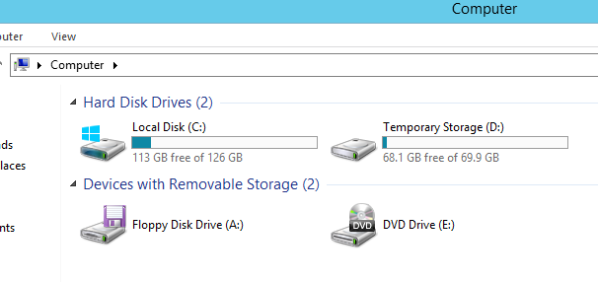
再次强调：正确使用虚拟机临时盘

Slide 21
动手实验
进入http://sdrv.ms/15ai3Ej，打开Labs Manual里的”虚拟机实验.pdf”

