Slide 1
Windows Azure 大数据
方兴， Technical Evangelist
DPE, Microsoft
我的博客：http://blog.csdn.net/shaunfang
Azure技术讨论组(QQ): 289913970
Version: November, 2012

Slide 2
内容
什么是大数据?
HDInsight: Windows Azure + Hadoop
使用 HDInsight 开发
Notes:
Slide Objectives:
Understand Big data and why it is important
Know the basics of Hadoop architecture and use scenarios
Learn the different programming options
Transition:
Transition statement(s) to setup the slide
Speaking Points:
Speaking Point #1
Speaking Point #2
Notes:
Any notes go here

Slide 3
主要趋势
Device Explosion
Social Networks
Inexpensive
Storage
设备爆炸式增长
社交网络
价格低廉的存储
全球移动设备用户
>55 亿 (70+% 人口)
>20亿
互联的用户
< $100 / TB (1980 年
-2010年降价3百万倍)
Ubiquitous Connection
Sensor Networks
Inexpensive Computing
无处不在的连接
传感器网络
价格低廉的计算
Web 流量
2010年130 Exabyte (10 E18)
2015年 8 ZettaByte (10 E21)
>100 亿
联网的传感器
1980年 10 MIPS/$
2005年10M MIPS/$
Notes:
Slide Objectives:
Set up the problem: Devices, social network are causing an explosion of data. 1.8 Zbytes last year and in 2 years we will have 7.8 Zbyte worth of data being created each year.
Transition:
Transition statement(s) to setup the slide
Speaking Points:
New devices and use scenarios are creating more data than ever.
Cheaper Storage and compute makes it possible to process some of the data, thus “big data” tools and industry have been created.
Notes:
These are the trends that are triggering the big data revolution. Most of us are already familiar with them, however we need to take another look at them from new perspectives. Almost everyone here has one or more mobile devices, the world currently has 5.5 billion devices which reaches 70% of the world’s population. Social Network, such as Facebook and twitter, have more than 2 billion users and are growing fast, we will reach 7.2 Zetta bytes of information created per year by 2015.
In addition to the data humans are creating, the next growth area is sensornetworks or “internet of thigns”, we will have more than 10 billion networked sensors in the very near future.
At the same time, we are seeing two other trends that are going in the opposite directions, the cost of compute and storage have gone down rapidly. These two trends are also helping to grow the big data industry.
When you see an explosive growth of data and the rapid decrease of storage prices. There’s suddenly an opportunity to invest in big data. In return we get not only information, insight, but also increased productivity and competitiveness. Things we weren’t able to do before suddenly became feasible.
这场趋势推动了大数据的变革，大家都熟悉其中或者全部的趋势，但是我们需要用全新的眼光来看。大家都意识到移动设备的爆炸，每个人都有一个或者一个以上的移动设备。现在全世界的移动设备用户可能已经达到了55亿，这占了人口的70以上。社交网络，无论是Facebook还是Twitter，还是微博，用户超过了20亿，之后还会增长。这种连接性就是网络，流量数据的爆炸性增长。2015年我们预计会达到 7.2十的21次方。在几年之内这个数据会呈爆炸性的增长。
这不仅仅关乎到网络用户，还关乎到传感器，我们预计会有100亿的传感器连到网络上，这一切都为我们带来了大数据的新变革。
同时另外两种技术趋势也有通过作用，价格低廉的计算，我们可以花不到100美元就可以买到1个T的存储，只是十年前的1%。价格低廉的存储和计算是大数据的推动力。
当你看到数据量上涨，然后存储和计算代价在降。我们在上商言商 – 我在大数据上的投入，是为了换回新的信息、洞见和生产力。我的投入回报比是什么？
大数据时代的第一声号角就是宣告，随着高科技不断的创新，使得计算和存储都跌倒了白菜价格，还有云存储、云计算技术继续减低成本，我们从海量信息获取的信息量的价值和超过我们的投入了

Slide 4
什么是大数据？
大数据是具备高效益地分析大型的数据集和数据集之间相关性、提升行业决策和执行能力（如，发现商务趋势，审核科研质量，防御疾病，疏通交通、治理环境、打击犯罪行为等）的软硬件基础设施和应用技术的总称。
传感器等设备
Exabytes
(10E18)
Wikis / Blogs
Volume
Variety
Variability
Velocity
Social Sentiment
Sensors / RFID / Devices
Audio / Video
WEB 2.0
Mobile
Log Files
Petabytes
(10E15)
Volume
Advertising
eCommerce
Collaboration
Spatial & GPS Coordinates
ERP / CRM
Digital Marketing
Data Market Feeds
Terabytes
(10E12)
数据量
Payables
Contacts
Search Marketing
eGov Feeds
Payroll
Deal Tracking
Web Logs
Weather
Gigabytes
(10E9)
Inventory
Sales Pipeline
Recommendation
Text/Image
复杂性： 多样性,变化和速度 Variety, variability & Velocity
ERP / CRM
WEB 2.0
传感器等设备
硬盘价格/GB
1980
19万$
1990
9,000$
2000
15$
2010
0.07$
Notes:
Slide Objectives:
Types of data and the characteristics of big data
Transition:
Big data is not simply about the volume, but about how fast they move and their unstructured nature.
Speaking Points:
Volume: we’ve created 1.8 Zettabyte in the past year, and it will double every 1.5 years.
Data velocity adds to the difficulties; the SLA becomes much more difficult to service when you have constant incoming data such as social networks and internet of things. We just can’t simply stop data sources from producing data while we fix our systems.
Notes:
Variety = different types of data. and variability => data structure changes over time.
Gartner’s Merv Adrian in a Q1, 2011 Teradata Magazine article. He said,
“Big data exceeds the reach of commonly used hardware environments and software tools to capture, manage, and process it within a tolerable elapsed time for its user population.” 大数据超出了常用硬件软件工具在用户可容忍的时间内采集、管理和处理能力范围
McKinsey Global Institute in May 2011: “Big data refers to data sets whose size is beyond the ability of typical database software tools to capture, store, manage and analyze.”
大数据指超出典型数据库软件工具采集、存储、管理和分析能力的数据集
这两个定义我个人不敢苟同。 首先， 有循环定义的嫌疑。 大数据就是大。大和小是比较的。
大数据是海量的，是巨大的，它关乎数据量。1，数据量；2，广度、分类；3，速度。这代表了这个速度以及它这个类型的复杂性，代表了数据的复杂性。
十年前或者十五年前，我们当时有ERP和CM的数据，来自于我们的交易、产品销售、客户的数据，是一些词汇和数据。随着Web2.0时代的兴起，数据量开始攀升，同时数据的分类也不断地丰富，网页、文件、日志，新的数据存储形式就不断地兴起，这样我们需要新的数据平台对此分析和存储。今天在一个大数据的时代，电子商务、网络、传感器的数据流、太空数据，我们有更多的数据类型，并且衍生的数据非常之快，规模非常之大。因此，我们可以看到这个3V（量、速度、类型）概括了我们的大数据。
降了价所以可以存了，这句话是有问题的。
请问：大数据“大”字重要还是“数据”重要。 都不重要，你要拿它做什么最重要！
企业需要更大数据集合的趋势，是因为发现通过对多种相关的数据进行分析，我们可以得到更多的信息，远超过对这些数据集合单独分析的结果，2+1 > 3.
大数据时代是在存储和计算技术发展的新阶段，从收益上，人类采集、存储的数据中能够得到的价值已经超过了软硬件开销。从处理能力上来看，今天的云计算给了我们近乎无穷的处理机，使得人类能够及时地得到信息和洞见，从视角来看，不再是井底观天看一类数据，而是集成相关的商务数据、Web数据，传感器、社交网、地域时空数据来360度全景、全息地看世界。

Slide 5








大数据分析，有多种选择
NoSQL
SQL
Azure Tables
Azure SQL
HDInsight

Slide 6
所有这些，都可以在Windows Azure上应用
数据服务
服务名 | 说明
Azure Tables | Windows Azure上的列存储服务
Azure SQL | Windows Azure上的关系型数据服务
Azure HDInsight | Windows Azure上的Hadoop服务
可部署在IaaS虚拟机上的大数据技术
技术 | 安装位置
MongoDB | VM仓库
Cassandra | VM仓库
Neo4j | VM仓库
SQL server | Azure内置库
MySQL | VM仓库

Slide 7
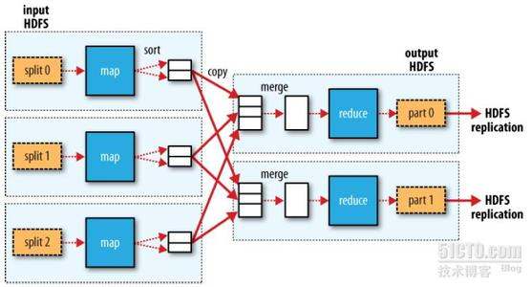
Hadoop是支持MapReduce计算模式的开源软件

Slide 8

Windows Azure HDInsight 服务

Slide 9

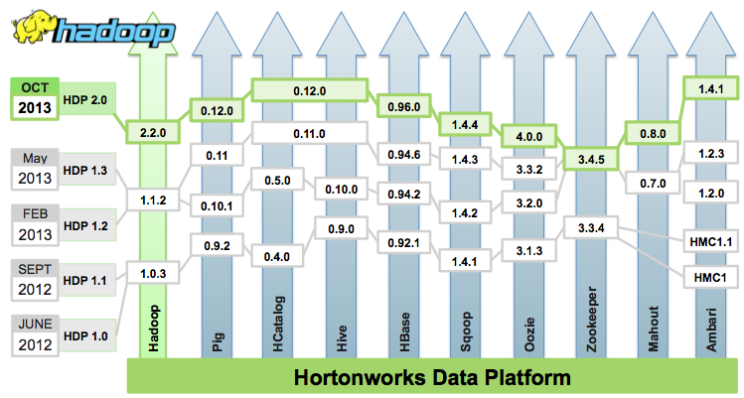
HortonWorks

Slide 10
HDInsight是什么
Windows版的HDP，加上一些微软的扩展
HDInsight
HDP
Hadoop
HDInsight 3.0
HDP 2.0
Hadoop 2.2
HDInsight 2.1
HDP 1.3
Hadoop 1.1.2
HDInsight 1.6
HDP 1.1
Hadoop 1.0.3

Slide 11

HDInsight 生态系统
Pipeline / workflow
(Oozie)
JavaScript
C#, F#, .NET
Graph
(Pegasus)
Stats processing
(RHadoop)
Machine Learning
(Mahout)
Data Integration
( ODBC / SQOOP/ REST)
Relational
(SQL Server)
Legend
Red = Core Hadoop
Blue = Data processing
Purple = Microsoft integration points and value adds
Orange = Data Movement
Green = Packages
Metadata
(HCatalog)
PDW Polybase
NoSQL Database
(HBase)
Scripting
(Pig)
Query
(Hive)
Event Driven Processing
Event Pipeline
(Flume)
Distributed Processing
(MapReduce)
Business Intelligence
(Excel, Power View, SSAS)
Distributed Storage
(HDFS)
Monitoring & Deployment (System Center)
World's Data (Azure Data Marketplace)
Azure Storage Vault (ASV)
Active Directory (Security)
Notes:
Slide Objectives:
Understand the HDInsight eco-system
Transition:
Transition statement(s) to setup the slide
Speaking Points:
Biggest buzzword in Big Data right now is Hadoop
It can mean many things, but always includes HDFS and MapReduce
HDInsight
Red = in product now
Blue = planned for product
Green = ecosystem can connect now
Purple = Samples available
Orange = ecosystem planned
Flume, HBase are not available in the first release of HDInsight Service
As of 3/15, we don’t have an on-premise solution, thus AD integration is not yet available.
System center integration will come later as well.
The Green boxes are packages in the ecosystem that have not been included in the service, but should work out of the box by downloading them.
Notes:
Any notes go here

Slide 12


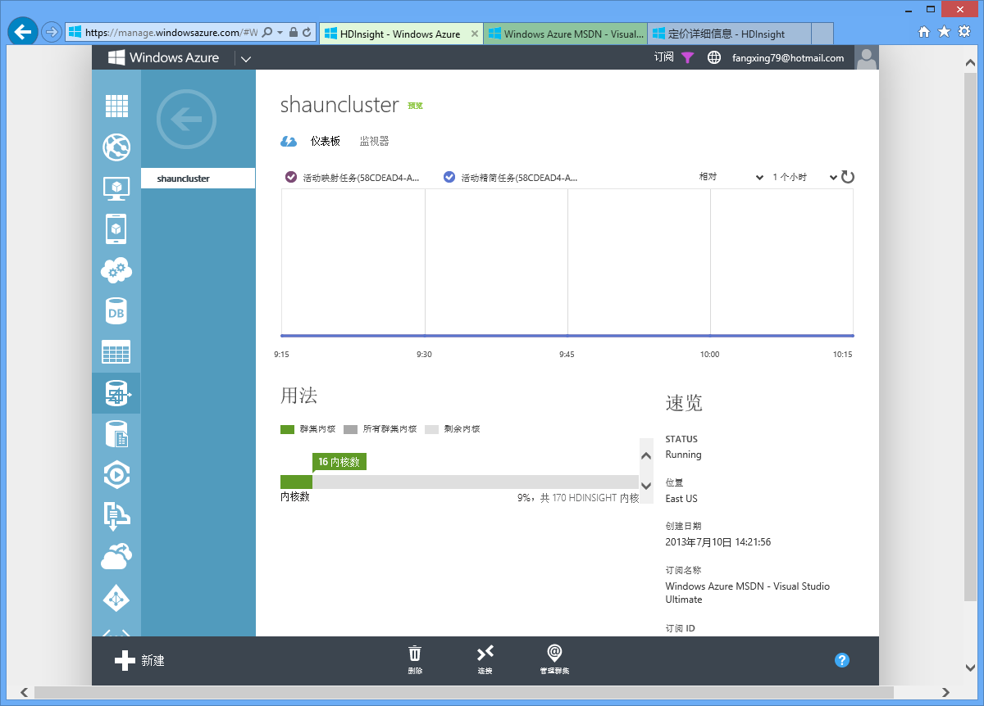
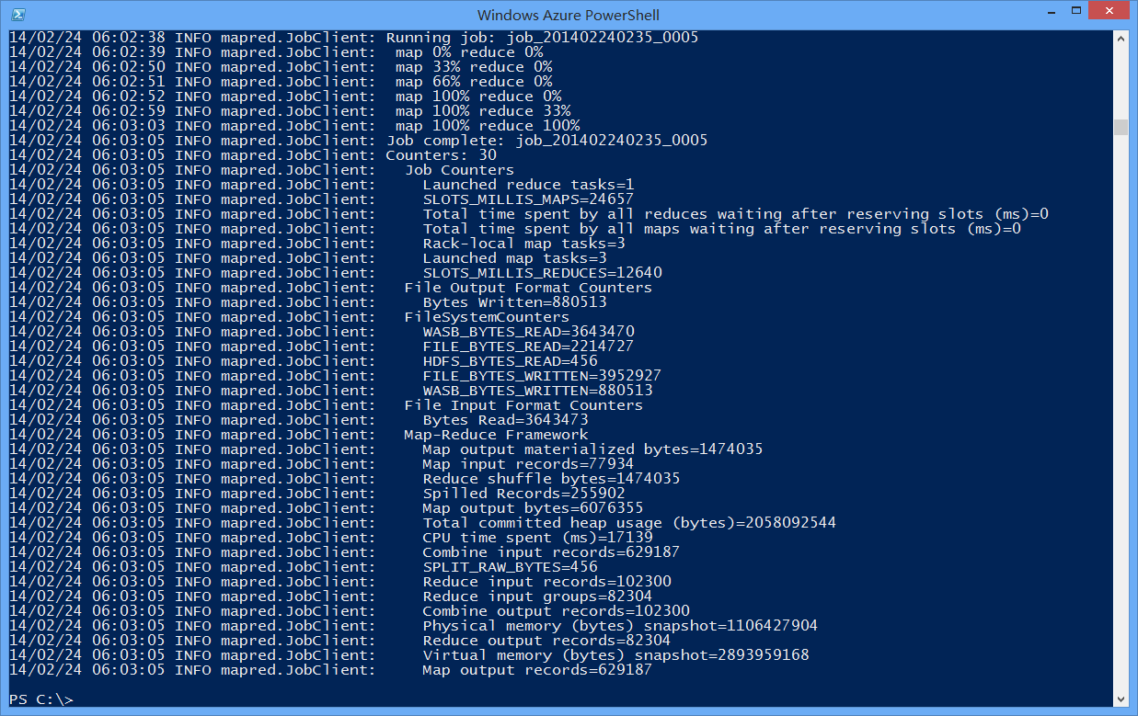
HDInsight使用模式
HDInsight 集群
头节点
XL虚拟机
用户
远程桌面
输入、输出文件
计算节点
L虚拟机
用户
部署、监控
管理界面
提交Hadoop/Pig/ Hive/Sqoop任务
Azure存储
计算节点
L虚拟机
Powershell/.NET SDK

Slide 13
部署，管理HDInsight 服务
演示
Notes:
Slide Objectives:
Objective #1
Transition:
Transition statement(s) to setup the slide
Speaking Points:
Speaking Point #1
Speaking Point #2
Notes:
Any notes go here

Slide 14
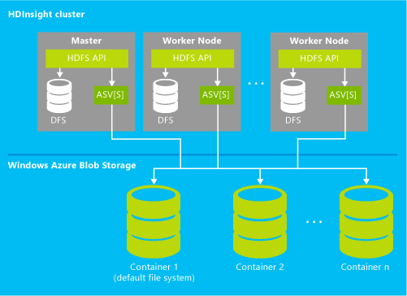
HDFS on Azure
Notes:
Slide Objectives:
Provides 1 layer to access both attached/local storage on each node and the remote Windows Azure Blog storage which is the default.
Transition:
Transition statement(s) to setup the slide
Speaking Points:
One interface to rule both DFS and Azure blob storage
Blob storage:
Front End: Security/Auth and scaled out request handler
Partition Layer: Object Layer, Mapping of objects such as Tables, Blobs, Queues to streams (cached in Front End), CC
Stream Layer: 3-Node HA, Scale-out stream store
Please see details from windows azure storage paper.
IN some ways ASV changes things again, we are now moving data to the compute, since data is now remote. Blob storage allows you to persist your data even when you tear down your cluster.
Notes:
Any notes go here

Slide 15
为什么用Azure Storage替代HDFS？
Azure Storage采用类似HDFS的理念，同样是分布式存储，1份数据3份拷贝
Azure Storage具有更好的可靠性 (99.9% SLA)和可扩展性，不受Hadoop计算节点资源限制
将数据与计算分离，让计算更有弹性
Hadoop集群可以存取整个本地云中任意的数据，无需频繁的数据拷贝，与其他应用集成更简便
弱化数据本地性，所有集群节点可对等访问所有文件，简化编程
注：集群通过以下格式定位文件
wasb://<container>@<account>.blob.core.windows.net/<path>
或者wasb:///<path> （缺省存储账号上的数据）
Notes:
Slide Objectives:
Understand the details of ASV
Transition:
Transition statement(s) to setup the slide
Speaking Points:
You will need to create an Azure storage account, you will need your acct name and key.
You should create a cluster close to where your data is. (storage in west should create a cluster in the west data center).
Notes:
Any notes go here

Slide 16
提交Hadoop任务
演示
Notes:
Slide Objectives:
Objective #1
Transition:
Transition statement(s) to setup the slide
Speaking Points:
Speaking Point #1
Speaking Point #2
Notes:
Any notes go here

Slide 17
HDInsight支持的命令
Add-AzureHDInsightConfigValues
Add-AzureHDInsightMetastore
Add-AzureHDInsightStorage
Get-AzureHDInsightCluster
Get-AzureHDInsightJob
Get-AzureHDInsightJobOutput
Get-AzureHDInsightProperties
New-AzureHDInsightCluster
New-AzureHDInsightClusterConfig
New-AzureHDInsightHiveJobDefinition
New-AzureHDInsightMapReduceJobDefinition
New-AzureHDInsightPigJobDefinition
New-AzureHDInsightSqoopJobDefinition
New-AzureHDInsightStreamingMapReduceJobDefinition
Remove-AzureHDInsightCluster
Revoke-AzureHDInsightHttpServicesAccess
Set-AzureHDInsightDefaultStorage
Start-AzureHDInsightJob
Stop-AzureHDInsightJob
Use-AzureHDInsightCluster
Wait-AzureHDInsightJob
Grant-AzureHDInsightHttpServicesAccess
Invoke-AzureHDInsightHiveJob
Notes:
Slide Objectives:
Understand the details of ASV
Transition:
Transition statement(s) to setup the slide
Speaking Points:
You will need to create an Azure storage account, you will need your acct name and key.
You should create a cluster close to where your data is. (storage in west should create a cluster in the west data center).
Notes:
Any notes go here

Slide 18
使用HDInsight开发
Existing Ecosystem
Hive, Pig, Mahout, Cascading, Scalding, Scoobi, Pegasus…
C#, F# Map/Reduce, LINQ to Hive, .NET management clients
.NET
JavaScript Map/Reduce, Node.js management clients
JavaScript
DevOps / IT Pros
PowerShell, Cross Platform CLI tools
Notes:
Slide Objectives:
Best of both world in terms of programming flexibility
Transition:
Transition statement(s) to setup the slide
Speaking Points:
We offer everything the Hadoop distribution offers.
In addition, we have made available javascript, browser hosted console, f#, c# linq2Hive to make life easier for .net /enterprise developers.
In addition, devops can use powershell and node.js based CLI to control and manage the cluster.
Notes:
Any notes go here

Slide 19
HDInsight的独特之处
洞察力
与微软商业智能软件结合
部署于Windows Server、Windows Azure之上，与微软众多软件/组件集成(AD, Systems Center)
为企业准备
部署配置便捷
支持.Net和Javascript简化开发
与SQL Server Data Warehousing集成
良好的集成
便捷的使用
新功能会更新到Hadoop社区发布版本里
Notes:
Slide Objectives:
Vision slide
Transition:
Transition statement(s) to setup the slide
Speaking Points:
Broaden access to Hadoop on the windows platform
Enterprise ready through AD, System center (to come).
BI integration and Self service BI
Notes:
Any notes go here

Slide 20
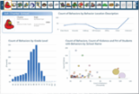

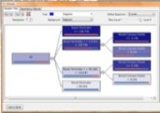

微软大数据方案
熟悉的工具
Power View
Excel with PowerPivot
Predictive Analytics
Embedded BI
商务智能平台
SSAS 分析服务
SSRS 报表服务
Microsoft EDW 企业数据仓库
Connectors
Hadoop On
Windows Azure
Hadoop On
Windows Server
非结构化数据 & 关系数据
Sensors
Devices
Bots
Crawlers
ERP
CRM
LOB
APPs
Notes:
Slide Objectives:
Talk from the bottom layer up to discuss the Microsoft big data solution.
Transition:
Transition statement(s) to setup the slide
Speaking Points:
BI Platform: Sql server analysis service and reporting service.
Self service BI: powerview, powerpivot, predictive analysis and embedded BI.
Taking in unstructured data and strutted data sources through Hadoop, or PDW
Notes:
Any notes go here

Slide 21
资源
HDinsight介绍 http://www.windowsazure.com/en-us/documentation/articles/hdinsight-get-started
Hadoop http://hadoop.apache.org/
HDP http://hortonworks.com/products/hdp-windows/
Notes:
Slide Objectives:
Objective #1
Transition:
Transition statement(s) to setup the slide
Speaking Points:
Speaking Point #1
Speaking Point #2
Notes:
Any notes go here

